Slide 1
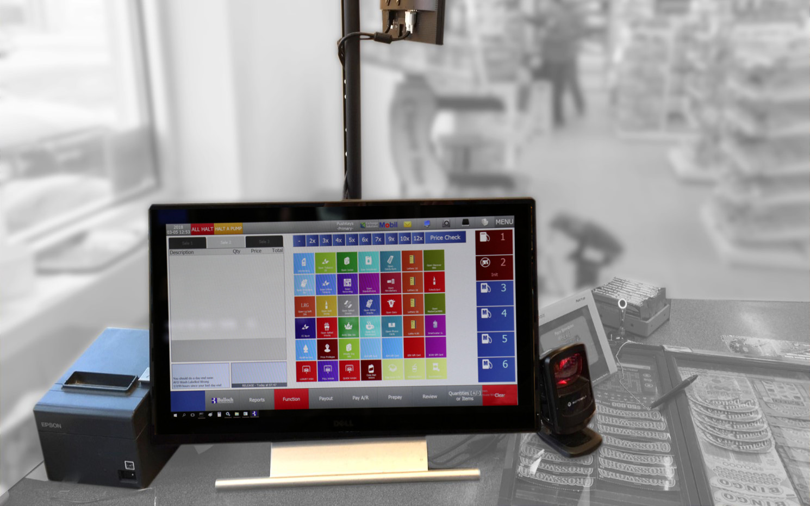
Bulloch Information Session for Retailers
Bulloch Information Session for Retailers
Lesson Overview - Introduction
Notes:
Bulloch Information Session for Retailers
Facilitator Guide
1

Slide 2
Bulloch Information Session for Retailers
About this Facilitation Guide
Lesson Overview - Introduction
Notes:
About this Facilitator Guide
This Facilitator Guide has been developed to:
Help you facilitate the workshop: Bulloch Information Session for Retailers
Help you provide an experience that is engaging, effective and efficient, which in turn will ensure that participants achieve the learning objectives of the workshop. The activities are designed to help all participants apply the concepts delivered.
Provide you with information on the purpose of the workshop: key learning objectives, agenda, workshop flow, list of materials and equipment, list of reference materials, and content and activity instructions.
This Facilitator Guide has been written for BW trainers.
IMPORTANT: How to Read this Facilitator Guide
Note Pages contain:
Time estimate at the top
Facilitation actions in Bold and generally found at the start of each sentence
Facilitation strategies that engage learning and gain participants’ attention
Activity instructions
Content to deliver

Slide 3
Bulloch Information Session for Retailers
Bulloch Information Session for Retailers
Objectives
Objectives
Lesson Overview - Introduction
Value-Based Pricing
Notes:
Performance Objectives
Overall Objective
By the end of the Bulloch Information Session, retailers will be able to confidently communicate and educate their staff on the new Bulloch system, using training program materials.
Specific Objectives
By the end of the Bulloch Information Session, retailers will be able to:
Describe the purpose of the Bulloch training (WHY)
Describe your role in this initiative
List the benefits of using the training to educate staff
List the expectations of the Point-of-Sale Training Program
Describe the changes to the system using the comparison chart
Describe the support available for Cashiers and Managers
Describe the best practices for changeover of the POS system
Bulloch Information Centre
Use the training program materials (WHAT)
List and describe the training program materials
Describe the design strategy of the training program materials
Describe how to use the training program materials and in what order
List the benefits and challenges of using the training program materials for new users
List ideas for introducing the training to staff (WHEN, WHERE, HOW)
List potential questions staff may have and discuss answers
List potential challenges and discuss solutions

Slide 4
Bulloch Information Session for Retailers
Workshop Timing
Lesson Overview - Introduction
Notes:
Workshop Timing
You can deliver this program three ways: small group, one-on-one, or virtual.
The suggested variations are included in this Guide. Schedule a 2-hour session for the one-on-one and the virtual session can be scheduled for 2.5 hours.
Total time for a live group session: 3 hours
Introduction 15 min
Describe the purpose of the Bulloch training (WHY) 60 min
Describe your role in this initiative
List the benefits of using the training to educate staff
List the expectations of the Point-of-Sale Training Program
Describe the changes to the system using the comparison chart
Describe the support available for Cashiers and Managers
Describe the best practices for changeover of the POS system
Bulloch Information Centre - Guided Tour
Break 15 min
Consider how to use the training program materials (WHAT) 25 min
List and describe the training program materials
Describe the design strategy of the training program materials
Describe how to use the training program materials and in what order
List the benefits and challenges of using the training program materials for new users
List ideas for introducing the training to staff (WHEN, WHERE, HOW) 20 min
List potential questions staff may have and discuss answers
List potential challenges and discuss solutions
Conclusion 15 min

Slide 5
Bulloch Information Session for Retailers
Recommended Room Layout
Lesson Overview - Introduction
Notes:
3 people
Table with Projector and Laptop
Table for workshop materials
3 people
3 people
3 people
Screen
Flipchart 1
Content on this page to be adjusted based on the number of expected retailers.
Recommended Room Setup
This layout may need to be modified to fit the room reserved.
Participants may vary between 3-12.
Ideally no more than 4 tables of 3 for up to 12 people
With less participants we can use 2-3 tables of 2 for up to 6 people.
With three participants, one table is enough.
Confirm number of participants and adjust layout before sending it to the hotel.

Slide 6
Bulloch Information Session for Retailers
Materials Needed
Lesson Overview - Introduction
Notes:
Checklist: Materials Needed for Workshop
For Facilitators: bring the following with you
For Participants: what to put out at each place
General Room Needs

Slide 7
Bulloch Information Session for Retailers
Bulloch Information Session for Retailers
Printing and Shipping Logistics
Printing & Shipping Logistics
Lesson Overview - Introduction
Value-Based Pricing
Notes:
Checklist: Printing & Shipping Logistics
What to include in shipment to training facility

Slide 8
Bulloch Information Session for Retailers
Preparation Checklist
Lesson Overview - Introduction
Notes:
Getting Ready for the Workshop

Slide 9
Bulloch Information Session
for Retailers
Notes:
First slide of workshop
SHOW when learners enter the room.
Have music playing as they take their seats.
Introduce yourself and welcome them to the session one-on-one.
Once it is time to start, EXPLAIN that this workshop will help them become familiar with the new Bulloch training program and provide them with support and practice on how to get their staff ready to learn the new Bulloch POS!

Slide 10

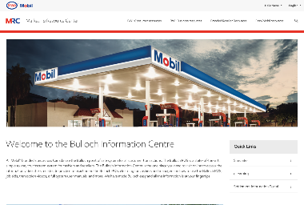


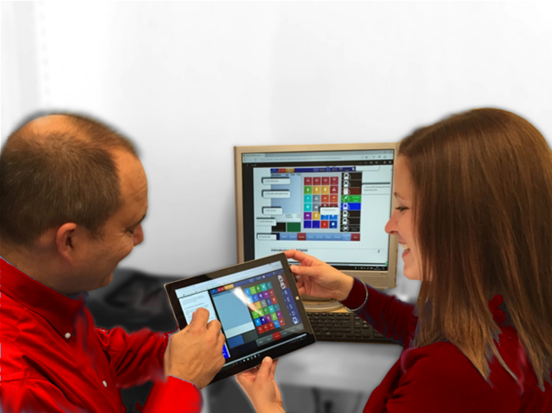
AGENDA
Introduction
Purpose of the Bulloch training
Use the training program materials
Introduce the training to staff
Conclusion
Notes:
Time: 2 min
EXPLAIN the items on today’s agenda.
EXPLAIN that the workshop is three hours long with two short breaks (for small group live session).
2-hour session for the one-on-one
2.5 hours for the virtual session

Slide 11
Expectations
What do you expect to accomplish upon completion of this workshop?
What knowledge or skills do you feel you “need to have” to help your staff transition to the Bulloch system?
What is your greatest challenge to confidently communicate and educate staff?
By the end of this workshop, you will be able to confidently communicate and educate your staff on the new Bulloch system, using training program materials.
Notes:
Time: 10 min
LARGE GROUP DISCUSSION
EXPLAIN that you would like to meet their expectations of today’s workshop and that you would like to know what you are expecting to walk away with once the workshop is over.
INVITE participants to share answers to any of these questions and add the answers to the prepared flipchart titled, Expectations.
EXPLAIN that you will return to this flipchart at the end to ensure the expectations were met and if not, what follow-up actions are required.

Slide 12
Working Together
Parking Lot
“Rules of the Road”
  Be engaged and participate – take responsibility to grow your skills
  Turn off your mobile
  Remain in the room
  Stay on task and on time
  Ask clarifying questions
  Respect opinions
  Help each other learn and grow
By the end of this workshop, you will be able to confidently communicate and educate your staff on the new Bulloch system, using training program materials.
Notes:
Time: 3 min
LARGE GROUP DISCUSSION
POINT to the prepared flipchart, titled, Parking Lot. Explain that given the carefully designed timing for this session, that you may invite participants to park their questions or suggestions to the Parking Lot to keep track of them and to return to them at the end of the workshop, as needed.
EXPLAIN that our goal is help you to confidently prepare for and use Bulloch and the training program materials.
INVITE participants to select the one item that they feel is the most important Rule of the Road to help us achieve our goal by the end.
SOLICIT a few answers and point out that Stay on Task and On Time is an important one, including returning from breaks on time (if you have any).

Slide 13
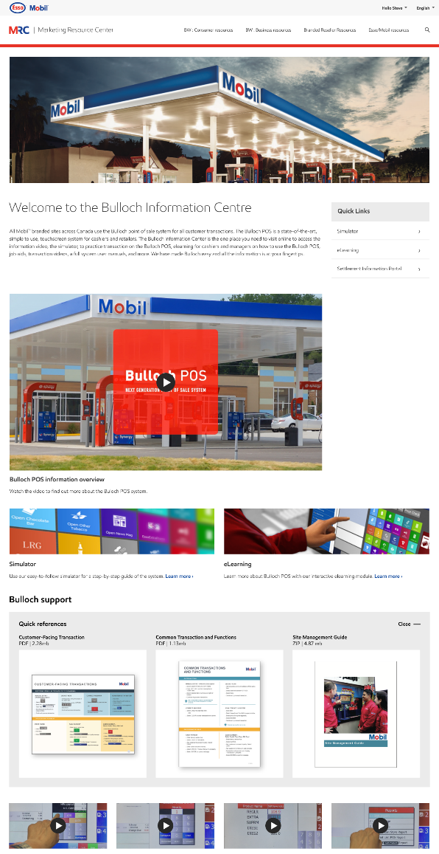
the purpose of the
Bulloch POS TRAINING
1
Your Role
2
Benefits
3
Implementation Expectations
4
Bulloch Information Centre
Notes:
Time: 2 min
EXPLAIN that the facilitators will now engage them in an interactive discussion on the purpose of the Bulloch training program.
EXPLAIN that in particular, we will be reviewing the topics listed on the slide.
HANDOUT high-level content that will be covered during this section.
INVITE learners to take notes as needed and to ask questions.
One-on-one: Use the handout to engage the retailer in a dialogue, make it as personal as possible.
Virtual: Run as designed.
You can assign breaks as needed for one-on-one or virtual sessions.

Slide 14
Your Role
Overall Role: Retailers role is to set their staff up for success in communicating, educating, and using the new Bulloch system and the training materials at their site(s).
Most Critical Outcomes for Retailers:
  Store Managers & Staff are prepared to use the Bulloch POS
  Accurately communicate to Store Managers & Staff
  Store Managers & Staff use the materials at each site
  Distribution/Use of learning materials
Notes:
Time: 2 min
EXPLAIN the role of the Retailer in this initiative.
ASK the following questions:
How does this role differ from other initiatives you have taken part in?
What aspects of this role challenges you the most?
What best practices can you share to help you shine in this role?

Slide 15
Benefits Of the training program to educate Staff
Easy and simple to use.
Simulator offers practice time!
Training is developed to help you set up your sites for success using the learning materials.
Use materials to support the store managers and cashiers before, during and after the transition.
Notes:
Time: 4 min
EXPLAIN the benefits to educating staff.
ASK the following questions:
Why are these benefits important? Are they important to you and why?
What benefits are missing?
Will staff see these as benefits?
What best practices can you share to help convey these benefits to increase their confidence and willingness to use the training materials and communicate to staff with confidence?
FACILITATION NOTES:
By attending the Bulloch Information Session, Retailers will benefit in the following ways:
Will gain a thorough understanding of what is new with the Bulloch POS and how it will affect some of their day-to-day operations.
A thorough understanding of the materials will help Retailers set their sites up for success with using the learning materials.
Knowing the information that is available to them (e.g., detailed Specific Transactions Guide, Sample Reports) will allow them to better support the Store Managers and Cashiers at their sites before, during and after the transition.
Will have the opportunity to ask questions specific to their location/situation.

Slide 16
IMPLEMENTATION expectations
Expectations of the Point-of-Sale training program to retailers
Important new features
Support available to Cashiers and Managers
Changeover best practices
Notes:
Time: 2 min
PROVIDE information of each of the sections on the slide.
INVITE participants to add important information to them on their handout.
ASK the following questions:
What do you think of this information?
How is this information helpful?
What questions do you have?

Slide 17
Bulloch Information Centre
Guided Tour
Overview
Simulator
eLearning
Support Resources (PDF Files)
  Customer Facing Transactions
  Common Transactions & Functions
  Site Management Guide
How-To Videos
Reference Manual
FAQ
Notes:
Time: 45 min
LAUNCH the Bulloch Information Centre and OFFER a very high-level guided tour. Each participant should have access to the site through a device. (PC, Tablet or phone)
EXPLAIN that the tour will be brief but people can access the Bulloch Information Centre and all the materials following this workshop.
EMPHASIZE the importance of referring to the Bulloch Information Centre to ensure they are receiving the most updated documents.
Overview – play overview video.
Simulator – access and try a few of the Cashier, Manager and Knowledge Check Simulations.
eLearning – access and work through the eLearning program.
Support Resources – click into and review each Quick Reference Guide.
How-To Videos – access and play a few of the videos.
Reference Manual – click into and review the Bulloch Reference Guide.
FAQ – click into and review the Frequently Asked Questions.
ASK the following questions:
What is your impression of the learning materials?
How will the retailers and staff react to this?
What questions do you have?

Slide 18
By the end of this workshop, you will be able to confidently communicate and educate your staff on the new Bulloch system, using training program materials.
Questions &
Key Learnings
Notes:
Time: 5 min
REVIEW the topics
from this section:
ASK:
What questions do have on this section?
What are your top learnings?
ANNOUNCE a 15-min break.
INVITE participants to return on time.

Slide 19
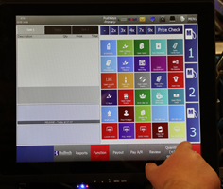
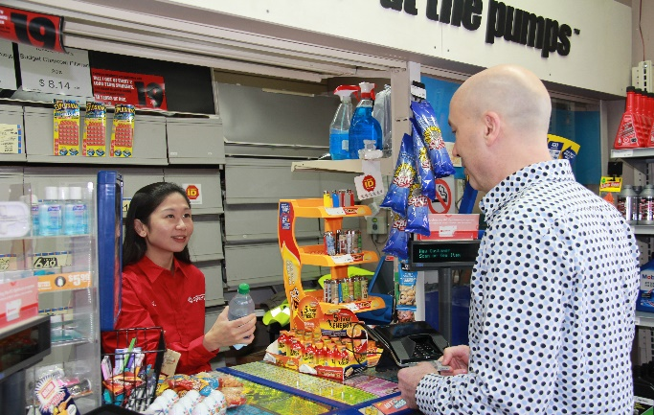
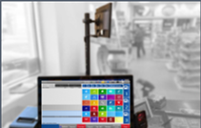
How to Use the Training Materials
1
Bulloch Information Centre materials
2
Learning material design
3
How to use the training materials
4
Benefits/Challenges for new users
Notes:
Time: 20 min total
HANDOUT the Job Aid which includes high-level information for each objective.
Bulloch Information Centre – Discussion (5 min)
Ask: “How would you walk through or present the eLearning Program and resource materials?”
Learning material design – Worksheet Activity (5 mins)
Review how to use the training program materials (5 mins)
Walk through the Preparing Your Staff section of Site-Management-Guide (pages 22, 23 and 24)
Review the benefits & challenges for new users (5 mins)
DEBRIEF the activity and provides feedback as needed
One-on-one: Use the handout to engage the retailer in a dialogue and ask questions to check for understanding. Given this is like a one-on-one coaching, have the retailer simulate a conversation with their staff and you can provide constructive feedback to help them.
Virtual: Send the handout ahead of time. Engage the retailer(s) in an interactive discussion asking them to share ideas on how they will communicate this to their staff. Invite 2-3 retailers to use their own words to simulate a presentation with staff.
You can assign breaks as needed for one-on-one or virtual sessions.

Slide 20
By the end of this workshop, you will be able to confidently communicate and educate your staff on the new Bulloch system, using training program materials.
Questions &
Key Learnings
Notes:
Time: 5 min
REVIEW the topics
from this section:
ASK:
What questions do have on this section?
What are your top learnings?

Slide 21
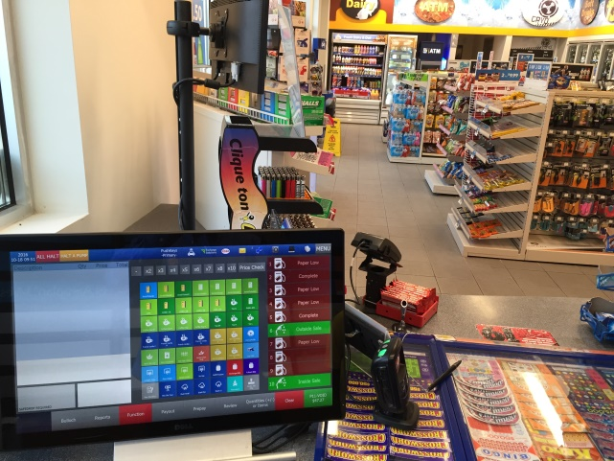
Introduce TRAINING to staff
Staff Questions & Answers
Staff Challenges & Solutions
Staff Success with Bulloch
Strive for Success
Notes:
Time: 2 min
INTRODUCE this section and the topics.
EXPLAIN that you will be having a large group brainstorm and that the information will be very helpful for them.
EXPLAIN that these activities will be pivotal in helping you communicate and educate with confidence.
One-on-one: Run as designed.
Virtual: Run as designed.

Slide 22
Group Brainstorm
Potential Staff Questions
Potential Staff Challenges
Potential Staff Successes
25 min
Notes:
Time: 15 min
ENGAGE participants in a large group discussion using the three topics listed on the slide.
USE the flipchart to document the discussion and encourage participants to take note and/or take pictures of the flipchart for them to use at their sites.
Small Group Brainstorm: potential questions staff may have and sample answers they would provide (5 min)
Small Group Brainstorm: potential challenges staff may have and sample answers they would provide (5 min)
Small Group Brainstorm: potential successes staff may have and how to encourage continued success (5 min)

Slide 23
By the end of this workshop, you will be able to confidently communicate and educate your staff on the new Bulloch system, using training program materials.
Most Important Question, Challenge or Success
Notes:
Time: 3 min
ASK:
What do you feel is the most important question, challenge, or success?

Slide 24
Next steps
Discuss:
  What are your next steps?
  Who to contact and when
  List critical and important tasks
5 min
Notes:
Time: 5 min
SAY: Now what?
LIST the next steps.
One-on-one: Run as designed.
Virtual: Run as designed.

Slide 25
Expectations
What do you expect to accomplish upon completion of this workshop?
What knowledge or skills do you feel you “need to have” to help your staff transition to the Bulloch system?
What is your greatest challenge to confidently communicate and educate staff?
By the end of this workshop, you will be able to confidently communicate and educate your staff on the new Bulloch system, using training program materials.
Notes:
Time: 4 min
REVIEW the expectations from the flipchart created at the beginning.
ASK if they were met.
If not, discuss how best to address the issues.
REFER to Parking Lot to see what is there and if any items need follow-up.

Slide 26
OBJECTIVES
Introduction
Purpose of the Bulloch training
Use the training program materials
Introduce the training to staff
Conclusion
Notes:
Time: 1 min
REVIEW the objective of the session.
ASK if they were met.
If not, discuss how to address.

Slide 27
By the end of this workshop, you will be able to confidently communicate and educate your staff on the new Bulloch system, using training program materials.
Your TOP Key Learning
That You Will Use
Notes:
Time: 5 min
ASK each learner to share their number one key learning or outcome from the session that they will absolutely use going forward and to explain why.
THANK participants for their active participation and wish them well on their journey.

