Slide 1
Webinar considerations
Audience: Managers at Retail sites (Retailers/Dealers)
Objective
By the end of this webinar, Retailers will be able to:
understand they will receive reports via email and to check for them daily
access and use the Retailer Reports Guide for detailed reports information
navigate the day-end process including what to do when they miss the cut-off time
describe the updated ticket retrievals and chargebacks process
be familiar with other updates: pre-auth of credit cards and IDs BAMS/FD will use as reference in communications

Slide 2
Webinar considerations (cont.)
Learning Overview
This is the only facilitator-led training Retailers will receive.
This is designed to be delivered as a webinar through software such as WebEx. There are suggestions throughout this PowerPoint for how to deliver the training face-to-face.
After this training, Retailers should refer to the:
  Retailer Reports Guide for further details on reports
  Retailer Quick Reference Guide for a one-page (front and back) overview of the card processing upgrades at their site

Slide 3
Webinar considerations (cont.)
Facilitator Preparation:
When delivering the content, ensure your speech is clear and moderately paced.
The language in the Notes is appropriate for participants of differing levels of English. If improvising the script, please choose language carefully.
Enter all poll questions into the webinar software before starting the webinar.
Of the DTN reports that are available, find out which are planned to be sent to Retailers (by their BW). Provide that information when delivering the Reports content.
Review Retailer Reports Guide for detailed info on DTN reports.
Review the Retailer Quick Reference Guide to prepare to introduce it to participants.

Slide 4


Welcome to:
Card Processing upgrades - Retailers
The webinar will begin shortly.
Notes:
SAY
Welcome to this webinar focused on the Card Processing upgrades for Retailers.

Slide 5

introduction
Notes:
SAY
Hello, my name is [Facilitator name] and I will be your guide today in this custom webinar for Retailers!
Let’s get started.

Slide 6


tools
Raise hand
Chat
Poll questions
Notes:
TIME 1.5 min
DO
If presenting this session face-to-face, use this time to introduce any classroom tools and guidelines.
If presenting this via a webinar, introduce the webinar tools to participants:
Raise hand feature: Select the hand icon beside your name to raise your hand. Try it now – Raise your hand if you have attended a webinar before. You can also raise your hand if you have a question. We will pause when appropriate and address your question.
Text chat feature: We will pause for questions throughout the webinar today. At any time, you can enter comments and questions in the text chat box to send directly to the facilitator or to everyone attending. Try it now – Enter a greeting in the chat box and send it to everyone.
Polling feature: From time to time, you will answer questions related to the topic using the polling feature. Let’s try one now.
Poll question:
How can you ensure you get the most value from this webinar today?
a) Put away all distractions – cell phone, email, paperwork, etc.
b) Ask questions
c) Participate
d) Stand up and turn in a circle 3 times every 5 minutes.
e) a, b and c
Correct response: e
DO
Provide 15 seconds for participants to respond. Comment on the responses.

Slide 7
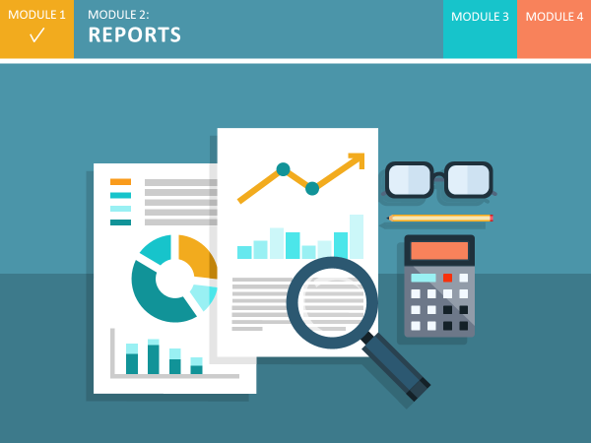

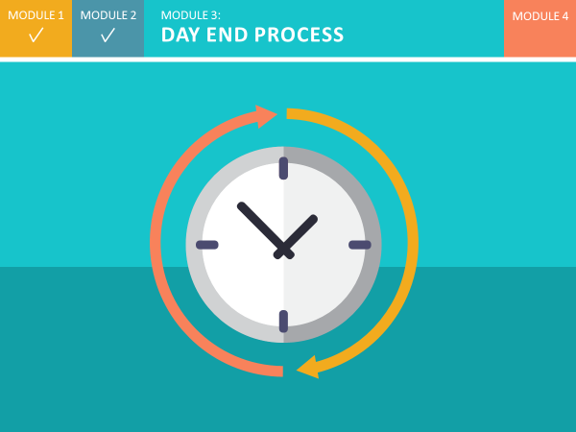
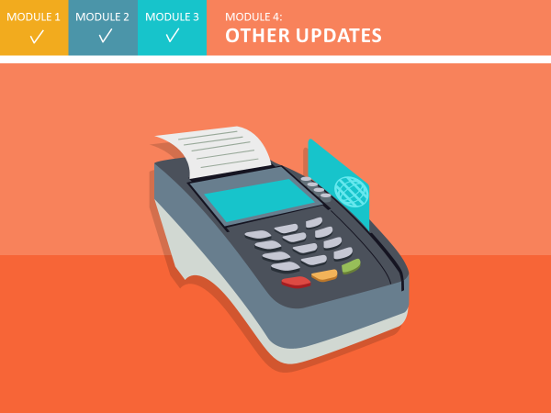
agenda
What’s new
Reports
Day end process
Other updates
Notes:
SAY
Here is our high level agenda for today’s session. We will cover 4 areas, namely:
What’s new
Reports
Day end process
Other updates
We will be pause from time to time to ask you to think questions about the content and check in with you.

Slide 8

rationale
Adopt industry standards
Leverage infrastructure
Replace legacy systems
Reduce potential security risks
Improve competitive advantage
Consolidated data
Notes:
SAY
We are adopting industry-standard systems and processes.
We are leveraging the ExxonMobil infrastructure and strategic direction.
We are replacing high-maintenance legacy systems and reducing potential for security issues.
We are improving risk management and our competitive advantage and indeed, consolidating settlement data in a single location – for better access to accurate data.
SAY
Overall, we are making the change to a modern system, provided by a well-respected banking services organization, to ensure we stay competitive in today’s world.

Slide 9
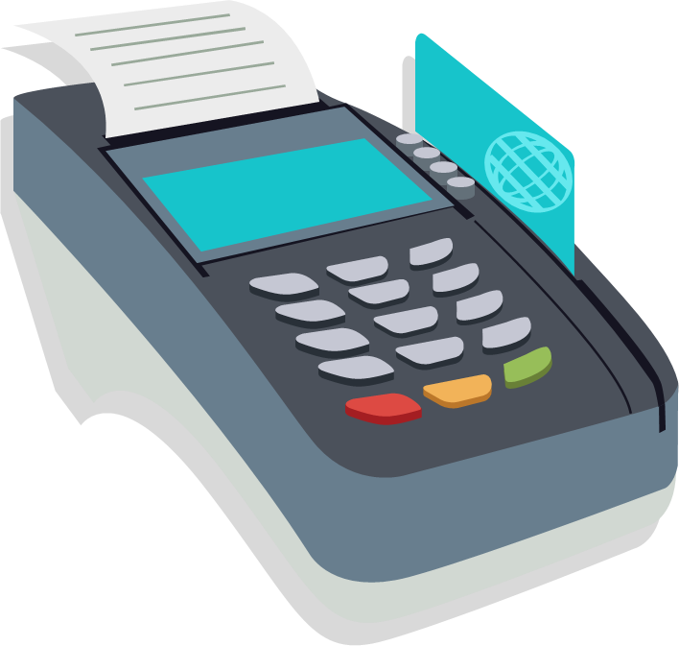
What to expect
New reports
Updated day end process
Other process updates
Notes:
SAY
You’re probably wondering how this will impact you. There will be a few processes to navigate – reports, an updated day end process, and a few other minor process updates to simplify the way you the business runs day-to-day.
We’ll introduce you to each of these today and talk about resources to support you.

Slide 10
MODULE 1
MODULE 2:
REPORTS
MODULE 3
MODULE 4
Notes:
SAY
For the rest of the webinar, we’ll take a look at what you can expect as the card processing upgrades are rolled out at your sites. Let’s begin with the first item on our agenda: reports for site settlement and loyalty.
When your site is switched over, you will still access the reports you currently use for daily reconciliation on your point-of-sale system. With the upgrade, your site will receive more detailed and up-to-date information from site settlement and loyalty reports delivered to you through email.
In this topic, we will provide an overview of the new reports and associated processes, and then introduce you to the Reports Guide. This guide provides everything you need to know about the reports.

Slide 11

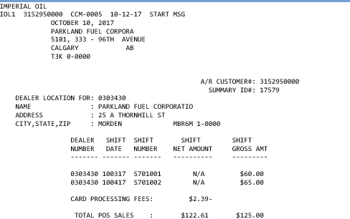
New Reports
Receive new reports via email
Get up-to-date data for reconciliation
Notes:
SAY
Your BW will have access to a system that generates reports and sends them to you via email. The system is called the Data Transmission Network, or DTN. The reports coming from this system are called DTN reports.
On initial setup, the BW will select which reports your site will receive. Once your site is set up by the BW, each report is automatically sent to you by email as soon as it is available. This could be daily, weekly or even monthly. This means you will have the very latest data to use for reconciliation.
The reports are very detailed and provide a lot of useful transaction data for your site. One point to note is there may be slight variations between day-end totals from the POS reports and those from the DTN reports. This is due to rounding performed on some of the calculations.

Slide 12
New reports
Code | Report Name | Description
CCM | Card Settlement Report | Day/Shift summary totals
DFM | Daily Card Sales Fee Report | Daily summary of total sales and card fees by card type
PCR | Price Privileges/Car Wash Redemption Report | Price Privileges/Car Wash dollar amounts for loyalty points redeemed
MSR | Multiple Sales Report | Daily report identifying multiple inside sales (credit only; no debit or Fleet) by truncated card number, to help detect possible fraud
FMM | Monthly Card Sales Fee Report | Monthly summary of the daily card sales fee reports
LDD | Daily Loyalty Detail Report | LDDa: Transaction level dollar amounts for loyalty points issued/redeemed LDDb: Transaction level details for loyalty points issued/redeemed
LPF | Daily Loyalty Potential Fraud | Under development – Summary of cards that were used multiple times at a site in one day
Notes:
SAY
Let’s now take a look at the new site reports that are available, and what information they provide. Here is the list of new reports and a brief description of each. You can see here that each report is identified by a 3 letter code. This code is always the same and will help you identify each report.
As a Retailer, you will most likely use:
CCM - Card Settlement Report – for Day/Shift summary totals and adjustments.
DFM - Daily Card Sales Fee Report – for a daily summary of total sales and card fees by card type.
PCR - Price Privileges/Car Wash Redemption Report for Price Privileges/Car Wash dollar amounts for loyalty points redeemed.
MSR - Multiple Sales Report for a daily report identifying multiple inside sales (credit only; no debit or Fleet) by truncated card number, to help detect possible fraud
FMM - Monthly Card Sales Fee Report for a monthly summary of the daily card sales fee reports
LDD - Daily Loyalty Detail Report which comes in two forms, the LDDa: presents the Transaction level dollar amounts for loyalty points issued/redeemed while the LDDb: displays the Transaction level details for loyalty points issued/redeemed.
And finally the LPF - Daily Loyalty Potential Fraud which remains under development and will provide a summary of cards that were used multiple times at a site in one day.

Slide 13
Codes used in reports
Code | Card Type
MC | Mastercard Mastercard Fleet
VI | Visa
DI | Discover
EB | Citi ExxonMobil Consumer Citi ExxonMobil Commercial Fleet
AX | American Express
DE | Interac Debit
GA | Esso and Mobil Gift Card Activation
GR | Esso and Mobil Gift Card Redemption
CA | Esso and Mobil Carwash Activate
CW | Esso and Mobil Carwash Redeem
CP | Price Privileges Activate
CD | Price Privileges Card Redeem
WX | WEX Esso and Mobil Fleet WEX Universal and Other Fleet
EF | WEX ExxonMobil Fleet
Code | Sales Activity Description
O – OUT | Outside Sales
I – IN | Inside Sales
Z – CREDIT/ DEBIT CARD | Credit or Debit Card
S – SPEEDPASS | Speedpass
P – PAPER | Not used in Canada
M – MOBILE | Speedpass+ Mobile Application
X – MCX | Not used in Canada
Notes:
SAY
Now that you’ve seen what is available, we will look at 2 of these reports starting with the Daily Card Sales Fee (DFM) report first and the Daily Loyalty Detail Report (LDDa) report next.
A key point when reviewing these reports is to note the codes that are used within each report. There are codes for the types of cards used and to describe the type of sales activities listed.
You can find all of these details and a thorough description of each report in the Retailer Reports Guide. We will look at it in more detail in a few moments.

Slide 14
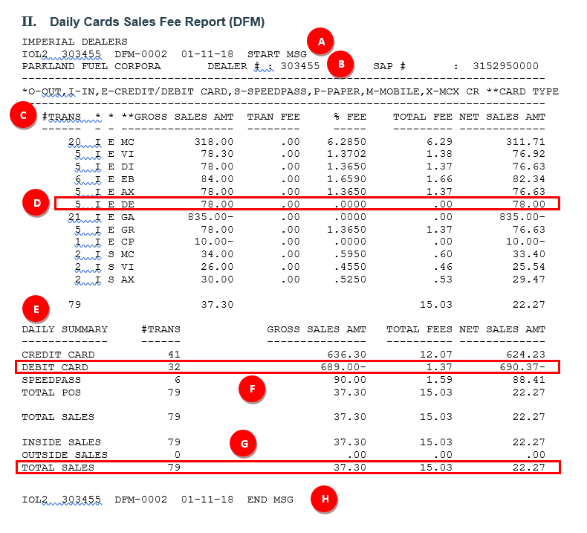
Example Report 1 - DFM
A
Report start message
B
First Retailer number
C
Transaction information for Retailer
(see Retailer Reports Guide for details)
D
DE (Interac Debit)
E
Summary information for Retailer
F
Debit card summary
(see Retailer Reports Guide for details)
G
Total sales
H
Report end message
Notes:
SAY
This is the Daily Card Sales Fee or DFM report. It includes a daily summary of total sales and card fees by card type.
Let’s quickly review the key parts of the report using the references on this slide.

Slide 15
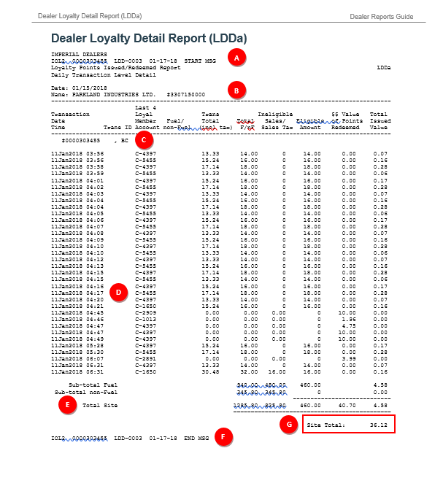
Example Report 2 - LDDa
A
Report start message
B
BW name
C
Retailer number
D
Transaction information for Retailer
E
Summary information for Retailer
F
Report end message
G
Site total
Notes:
SAY
This is the Daily Loyalty Detail or LDDa report. It includes the transaction level dollar amounts for loyalty points issued and redeemed.
Again, I will point out the key parts of the report using the references on this slide.

Slide 16
Retailer reports Guide
Notes:
SAY
So far, we have provided an overview of the reports that are available for site settlement and loyalty, and looked at a couple of them in a little more detail.
To assist you with reading the reports, and using them for reconciliation at your site, you can refer to the Retailer Reports Guide. The Guide is a PDF that you can view online, or print and keep. The guide provides you with detailed information on each report available to you, similar to the information we just reviewed on the last 2 slides, with greater detail.
Note that the content will be updated over time. If you print it, check back from time to time for any updates that have been made.

Slide 17
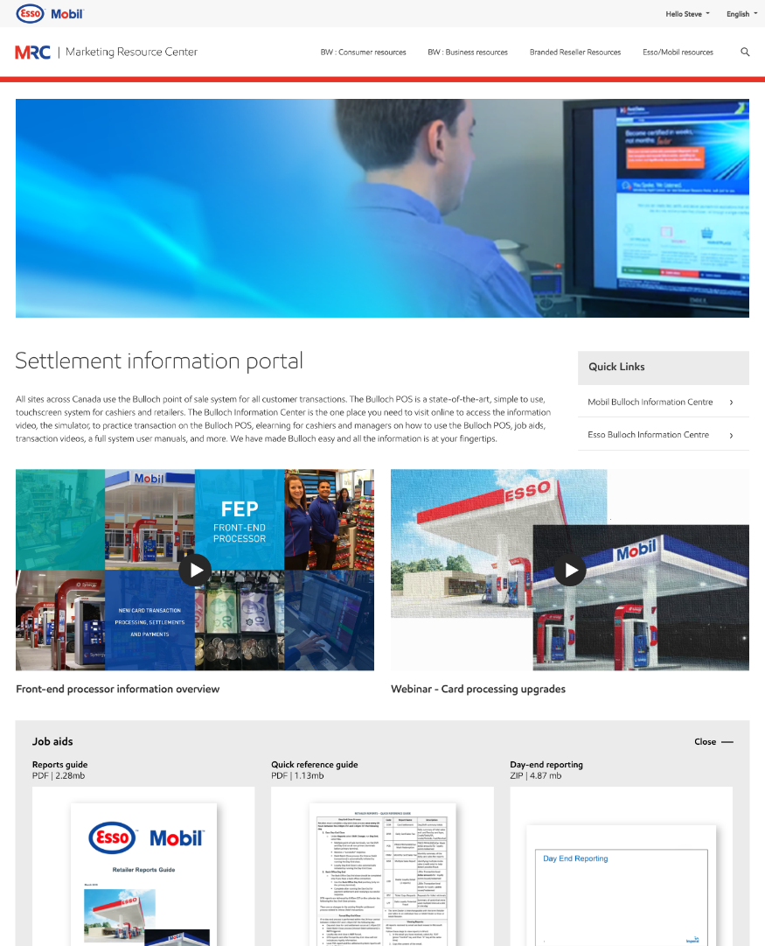
settlement information portal
Introduction video
Recording of this webinar
Retailer Reports Guide
Retailer Quick Reference Guide
Notes:
SAY
In addition to this training today, there are a number of resources to support you. They can all be found in one convenient, easy-to-access location: the Settlement Information Portal website.
This is the same website you may have used to access resources about the Bulloch point-of-sale system at your site. There is a new page at the same web location to provide support for the card processing upgrades.
On this web page you will find resources for Retailers. This includes a video that introduces the card processing upgrades coming to all sites, a recorded version of this training, the Retailer Reports Guide we just saw, and a Quick Reference Guide you can print for easy reference. The recording of this training can be helpful to refresh your memory, and when you have new Managers coming on to the site.
Note the portal resources will be updated from time to time as new reports become available. It will be useful to check the site periodically.

Slide 18
How might you use the reports to benefit daily operations?
Notes:
SAY
As mentioned, you will receive reports both via email and automatically.
Let’s pause for a minute and have you think about: how you might be able to use the reports to best benefit daily operations?
Here are some suggestions:
Preparing for the change will help keep operations running smoothly during the transition.

Slide 19
Poll question
Where and when will you receive the reports?
Via the mail, weekly
Via email, automatically as they are generated
Via email, daily
Notes:
TIME 1 min
POLL QUESTION
Where and when will you receive the reports?
Via the mail, weekly
Via email, automatically as they are generated
Via email, daily
SAY
The correct answer is B – Via email and automatically. Take a few moments to consider how you might be able to use the reports to best benefit daily operations.

Slide 20
Poll question
Where and when will you receive the reports?
Via the mail, weekly
Via email, automatically as they are generated
Via email, daily

Slide 21
?
Check-in
Questi ns
Notes:
TIME 2 min
FACILITATOR NOTE
If there are 5 or less participants or if this is being facilitated face-to-face, participants can ask questions by unmuting (webinar) or just asking (face-to-face).
For a webinar with 6 or more participants, direct them to use the text chat feature to ask questions.
SAY
You’ve taken in a lot of new information. Let’s take a moment to check in. What questions or comments do you have?

Slide 22
MODULE 1
MODULE 2
MODULE 3:
DAY-END PROCESS
MODULE 4
Notes:
SAY
As part of the upgrade, another update for Retailers is the revised day-end process. To ensure the most up-to-date data is included in the reports, and to help with effective and efficient business operations, the payment settlement system requires a day-end close to be performed once every 24 hours. Let’s talk about what this means for you.

Slide 23
Day-end Close every 24 hours
Perform a day-end close once every 24 hours between
2:00 pm and 1:45 pm EST the next day
Perform close by
11:59 pm EST
Notes:
SAY
Once your site is switched over, you’ll need to perform a day-end close with BAMS/FD once every 24 hours between 2:00 pm EST one day and 1:45 pm the next. To receive the most up-to-date reports, we recommend running your day-end close as close to 11:59 pm EST as possible. Running the day-end close as close to 11:59 pm EST as possible will capture the most recent transactions in the reports that are generated the next day.

Slide 24
Daily day-end close process
Day-End Close:
Under Reports, select Shift Change
When prompted to run Day End, select Yes
Debit batch close process triggered automatically by performing Day-End close
Loyalty Day-End close also triggered automatically
Notes:
SAY
Along with the daily close, there is an updated process for performing your day-end.
First, you will run a shift-end on the Bulloch POS by selecting Reports and then selecting Shift Change. When you select the Shift Change push key, a prompt will appear. It will ask if you also want to perform your day-end. Select Yes. This will run both your shift-end and day-end on this terminal.
Directly after you’ve performed the day-end close on the payment settlement system, you will receive a successful response from BAMS/FD.
Performing the day-end close initiates both the Debit Batch Close process and the Loyalty day-end process automatically. There are no changes to the existing Retailer settlement process related to Interac Debit transactions.
Note that if you have a back office connection, you will complete a back office day end after receiving a successful response from the day-end close. To run the back office close, on the POS, select the Reports push key and then select the Back Office Day End push key.

Slide 25
Day-end with multiple pos terminals
Step 1: Non-primary POS
Step 2: Primary POS
Step 3: Primary POS
Run shift & day-end on non-primary terminals
Run shift & day-end on primary terminal
If there is a Back Office connection, run a Back Office Day End on primary terminal
Text placeholder that goes on 2 lines
Text placeholder
Text placeholder
Notes:
SAY
If your site has multiple point-of-sale terminals, run the shift and day-end on all non-primary terminals first. Then, perform a final shift and day-end on the primary terminal.
The Back Office Day End push key will appear only on your primary or master terminal. Finally, if you have a Back Office connection, perform a Back Office Day End on the primary terminal.

Slide 26

Timing of reports
Retailers will receive DTN reports via email on a daily basis by ~6 am EST, for the day-end close completed the previous calendar day.
Notes:
SAY
Regardless of what time you close each day, BAMS/FD begins processing your day-end close information from the system at 11:59 pm EST every day. Your DTN reports will be available approximately 6 hours later. To see what this means to you, let’s look at a few examples.

Slide 27
day-end process – Example 1
Perform day-end close before 11:59 pm EST Tuesday:
Receive a successful day-end close response from First Data
DTN reports available by
~6:00 am EST Wednesday
Note: For all scenarios, timing for Moneris payment for Debit transactions stays the same as today.
Notes:
SAY
For this first example, let’s say you perform your day-end close process before 11:59 pm on Tuesday. Let’s assume we are working in Eastern Standard Time:
For this example, you run the shift end and day-end close on each POS before 11:59 pm EST on Tuesday. When you receive the successful response from First Data, your day-end is complete for payment, loyalty settlement and debit batch close.
Any DTN reports you receive by email will then be available by approximately 6:00 am EST on Wednesday.
Note that for all scenarios, timing for Moneris payments for Debit transactions will remain unchanged from when you currently receive them.

Slide 28
day-end process – Example 2
Perform day-end close after
11:59 pm EST Tuesday
(i.e. on Wednesday):
Receive a successful day-end close response from First Data
DTN reports available by
~6:00 am EST Thursday
Notes:
SAY
Now let’s look at an example of a site that performs their day-end after 11:59 pm EST:
After running the shift end and day-end on each POS terminal, the loyalty day-end and debit batch close are triggered automatically. When you receive a successful day-end close response from First Data you can run the Back Office Day End (if applicable) and then begin the next day’s sales.
After successfully running a day-end, the reports from the DTN portal will be available by 6:00 am EST Thursday.
A key point for you is, when your site is converted, there will be a 1 to 2 day period when you will not receive DTN reports. If you perform your close before 11:59 pm EST, it will be 1 day. If you perform your close after 11:59 pm EST, it will be 2 days.
After that, if you close at the same time each day, you will receive reports daily. We recommend you perform the day-end close around the same time each day to ensure you receive reports daily and receive funding consistently.

Slide 29
How to Change Day-end close time
Current day-end:
Day-end | Monday at 5:00 am EST
DTN reports | Tuesday am
New day-end:
Day-end | Monday before 11:59 pm EST
DTN reports | Tuesday am
Next day**:
Day-end | Tuesday before 11:59 pm EST
DTN reports | Wednesday am
**Reconcile 2 days of payment settlement and loyalty data
Notes:
SAY
Now that we’ve covered a couple of basic scenarios, let’s consider how you would change the time you normally perform your site’s day-end. You might do this for various reasons; maybe your site’s slow time of day has shifted, or maybe you want to process settlement sooner. Let’s see how to do this.
DO
Review the points on the slide.
Note for participants again that the system allows only one day-end close to be performed within 24 hours between 2:00 pm EST one day and 1:45 EST the next.
SAY
After you have successfully moved the time you perform your day-end close, you should close around the same time every day.

Slide 30
What if I miss the cut-off time?
If a site hasn’t performed a day-end close in the last 24 hours:
At 1:45 pm EST, BAMS/FD will force a day-end close
Loyalty day-end close (and debit settlement) won’t occur
Local POS report and settlement system report will not balance
Notes:
SAY
So what happens if you forget to perform a day-end close within 24 hours?
At 1:45 pm Eastern Standard time, BAMS/FD will automatically close the day, pulling the site data from their end. This forced day-end will NOT trigger the loyalty day-end close or debit batch close to be completed. When you run your loyalty day-end and debit batch close after 1:45 pm EST, they will be out of balance with the credit and gift card settlement.
Also, the local POS report and the settlement system report will not balance.

Slide 31
Reconciling after a forced close
Wait until next regular day-end close time
Perform the day-end close process (day-end and loyalty day-end)
Reconcile using combined report from the day-end close. It will contain 2 days of data.
Notes:
SAY
If you missed the day-end close cut off time and BAMS/FD forced the day-end close, we recommend you do the following:
Wait until the next regular day-end closing time to run a day-end close. Then, you will reconcile both days using one combined report. It will include the data from the forced close, and the data from the day-end completed the next day (the day after the forced close). You will have more data to reconcile, but the combined DTN reports should balance with the combined local ones.
As mentioned a few moments ago, you can easily avoid this situation by performing the day-end at approximately the same time every day.

Slide 32

Alerts & Reminders
Customizable alerts
Reduced out-of-balance situations
Notes:
SAY
To help you with the updated process, you will be able to set customizable alerts on your point of sale system as a reminder to perform the day-end by the correct time. As a result of this daily close, you will see a reduction in out-of-balance situations when reconciling site totals with data in settlement.

Slide 33
How can you prepare your site to ensure the updated day-end close process is followed?
Notes:
SAY
It’s now time for another pause to think about the sites you manage. How can you prepare your site to ensure the updated day-end close process is followed?
Some suggestions are:
Train your team on what they need to know
Become familiar with the resources on the settlement information portal website
Communicate with your BW about any questions you have
And continue to think about other ways to best prepare your sites.
As the Retail site manager, your role is to communicate the updated process to your team, and support them with what they need to be successful.

Slide 34
Poll question
How can you prepare your site to ensure the updated day-end close process is followed? All answers are correct.
Train your team on what they need to know
Become familiar with the resources on the settlement information portal website
Communicate with your BW about any questions you have
Other
Notes:
TIME 1 min
POLL QUESTION - SELECT THE BEST RESPONSE. ALL ANSWERS ARE CORRECT
How can you prepare your site to ensure the updated day-end close process is followed?
Train your team on what they need to know
Become familiar with the resources on the settlement information portal website
Communicate with your BW about any questions you have
Other
DO
Review and comment on responses as they are entered. If any participant responded “Other”. Ask if they would like to go off mute and share their ideas.
SAY
Thank you for sharing your ideas. As the Retail site manager, your role is to communicate the updated process to your team, and support them with what they need to be successful.

Slide 35
MODULE 1
MODULE 2
MODULE 3
MODULE 4:
OTHER UPDATES
Notes:
SAY
Let’s continue on.
We’ve covered the new processes related to reports and day-end close. These are the changes with the biggest impact to you. There are a few other process changes to tell you about, so let’s do that now.

Slide 36
Pre-authorized transactions
Credit card transactions pre-authorized
Notes:
SAY
All site credit card transactions will be pre-authorized. This will provide better fraud protection for both you and the customer.

Slide 37
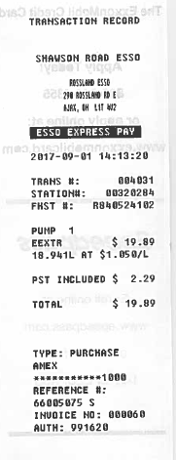
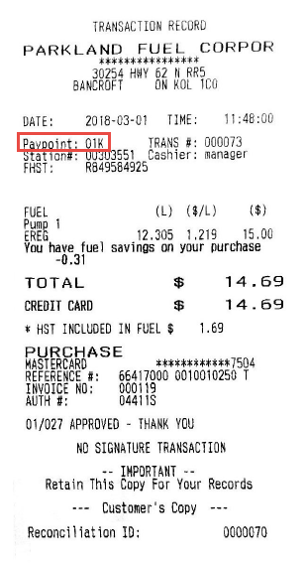
ID Number
Transaction and receipt identification numbers
Notes:
SAY
Last, when you receive requests related to transactions or receipts, they will be identified by the invoice number and either the pump number or pay point number.

Slide 38
How can your BW best support you during the updates?
Notes:
SAY
Okay, now to one of the most important topics.
These updates will provide you with more simplified, up to date processes to help you and the business as a whole, remain competitive.
Thinking of your regular communication channels with your Branded Wholesaler, in what ways can your BW best support you during the updates?
Some suggestions are:
Support you with training for your team
Communicate to you any new information about the upgrade
Check in with you after the upgrade for any questions you have

Slide 39
Poll question
How can your BW best support you during the updates? All answers are correct.
Support you with training for your team
Communicate to you any new information about the upgrade
Check in with you after the upgrade for any questions you have
Other
Notes:
TIME 1 min
POLL QUESTION - SELECT THE BEST RESPONSE. ALL ANSWERS ARE CORRECT
How can your BW best support you during the updates?
Support you with training for your team
Communicate to you any new information about the upgrade
Check in with you after the upgrade for any questions you have
Other
DO
Review and comment on responses as they are entered. If any participant responded “Other”. Ask if they would like to go off mute and share their ideas.
Note any information that would be helpful to BWs in supporting their sites and provide it to our contact at Imperial (John Campa).
SAY
Thank you for sharing your ideas.

Slide 40
SUPPORT &
NEXT STEPS
To Do List:
Review any BW communications about the updates to come.
Watch the introduction video to the card processing upgrades on the Settlement Information Portal website.
Review the Retailer Reports Guide on the website.
Review the Retailer Quick Reference Guide on the website.
Ensure staff are aware of the updated processes. Direct them to the recording of this webinar on the website to assist their training.
Contact Retail Help Desk for troubleshooting assistance, as always.
Notes:
SAY
Let’s talk about next steps and support available to you.
Review any BW communications about any upcoming updates.
Watch the introduction video to the card processing upgrades on the Settlement Information Portal website.
Access and review from the website, the Retailer Reference Guide to help you navigate reports as well as a Retailer Quick Reference Guide.
Ensure staff are aware of the updated processes. Direct them to the recording of this webinar on the website to assist their training.
As before, sites will contact Retail Help Desk for troubleshooting assistance.

Slide 41
?
Q & A
Questi ns
Notes:
TIME 5 min
FACILITATOR NOTE
If there are 5 or less participants or if this is being facilitated face-to-face, participants can ask questions by unmuting (webinar) or just asking (face-to-face).
For a webinar with 6 or more participants, direct them to use the text chat feature to ask questions.
SAY
Thank you for attending and for your participation today. We have some time left to address any questions you might have. What questions or comments do you have?

Slide 42
THANK
YOU
Notes:
SAY
That completes the summary of the updated and simplified solution to front-end processing and settlement. Thank you for attending and for your attention today. If you have any questions or comments, please remember to reach out to your support team.
Thank you again for attending.

