Slide 1
Webinar considerations
Audience
BW representatives who:
would like an overview of the upcoming change
will manage the DTN portal
will assist Retailers with navigating the updates
Objective
BWs know what to expect with the upcoming change, what training and resources will be made available and how to access them.
To prepare BWs to help their sites navigate the change.

Slide 2
Webinar considerations (cont.)
Learning Overview
This is the first training BWs will receive.
This is designed to be delivered as a webinar through software such as WebEx. There are suggestions throughout this PowerPoint for how to deliver the training face-to-face.
After this training, BW representatives who will be managing the DTN portal should:
  attend the DTN virtual training
  refer to the DTN User Guide
  Refer to the DTN Quick Reference Guide

Slide 3
Webinar considerations (cont.)
Facilitator Preparation:
Enter all poll questions into the webinar software before starting the webinar.
Confirm DTN portal log in web page.
Familiarize yourself with the different types of DTN reports available via the online DTN portal. To do this, refer to the DTN User Guide.
Of the reports that are available, find out which reports your BW will use for themselves and which they will send to Retailers.
Familiarize yourself with the DTN Quick Reference Guide to introduce it to this audience.

Slide 4


Welcome to:
Card Processing upgrades - BW
The webinar will begin shortly.
Notes:
FACILITATOR NOTE
Welcome to this webinar focused on the Card Processing upgrades for Branded Wholesalers.

Slide 5

introduction
Notes:
Suggested SAY
Hello, my name is David Fisher and I will be your guide today in this custom webinar for BWs!
Let’s get started.

Slide 6


tools
Raise hand
Chat
Poll questions
Notes:
TIME 1.5 min
DO
If presenting this session face-to-face, use this time to introduce any classroom tools and guidelines.
If presenting this via a webinar, introduce the webinar tools to participants:
Raise hand feature: Select the hand icon beside your name to raise your hand. Try it now – Raise your hand if you have attended a webinar before. You can also raise your hand if you have a question. We will pause when appropriate and address your question.
Text chat feature: We will pause for questions throughout the webinar today. At any time, you can enter comments and questions in the text chat box to send directly to the facilitator or to everyone attending. Try it now – Enter a greeting in the chat box and send it to everyone.
Polling feature: From time to time, you will answer questions related to the topic using the polling feature. Let’s try one now.
Poll question:
How can you ensure you get the most value from this webinar today?
a) Put away all distractions – cell phone, email, paperwork, etc.
b) Ask questions
c) Participate
d) Stand up and turn in a circle 3 times every 5 minutes.
e) a, b and c
Correct response: e
DO
Provide 15 seconds for participants to respond. Comment on the responses.
SAY
Our time together today will be an interactive 45 minutes. Let’s get started.

Slide 7
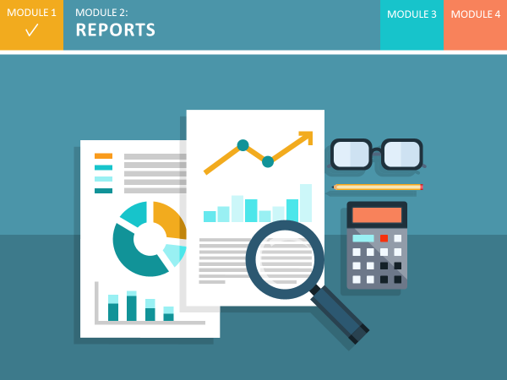

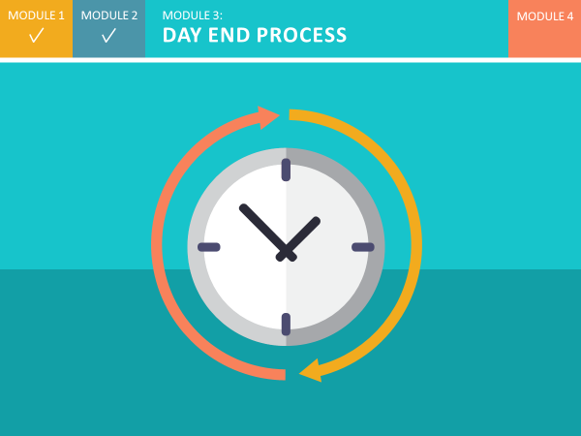
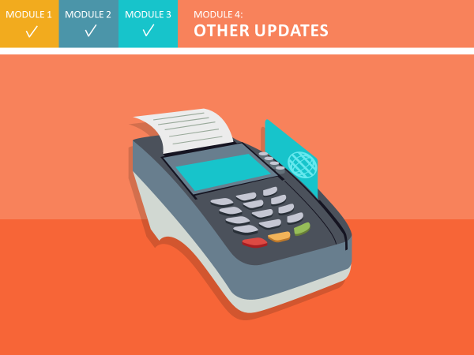
agenda
What’s new
Reports
Day end process
Other updates
Notes:
Here is our high level agenda for today’s session. We will cover 4 areas, namely:
What’s new
Reports
Day end process
Other updates
We will be pause from time to time to ask you to think questions about the content and check in with you.

Slide 8

rationale
Adopt industry standards
Leverage infrastructure
Reduce potential security risks
Improve competitive advantage
Consolidated data
Notes:
SAY
We are adopting industry-standard systems and processes.
We are leveraging the ExxonMobil infrastructure and strategic direction.
We are reducing potential for security issues.
We are improving risk management and our competitive advantage and indeed, consolidating settlement data in a single location – for better access to accurate data.
SAY
Overall, we are making the change to a modern system, provided by a well-respected banking services organization, to ensure we stay competitive in today’s world.

Slide 9
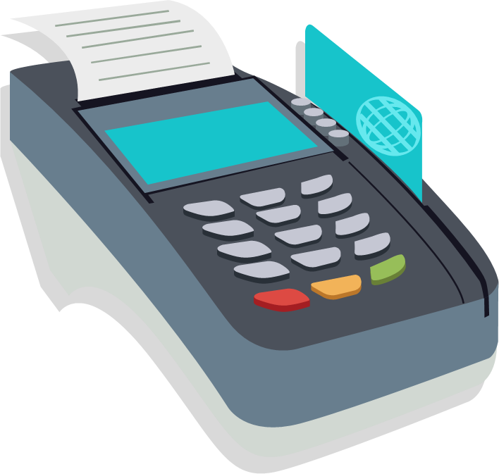
What to expect
New reports
Updated day end process
Other process updates
Notes:
SAY
Now that you know the reasons for this change, you’re probably wondering how this will impact you. There will be a few processes to navigate – new reports, an updated day end process, and a few other minor process updates to simplify the way you the business runs day-to-day.
We’ll introduce you to each of these today and talk about resources to support you.

Slide 10
MODULE 1
MODULE 2:
REPORTS
MODULE 3
MODULE 4
Notes:
SAY
For the rest of the webinar, we’ll take a look at what you can expect as the card processing upgrades are rolled out at your sites. Let’s start with Reports.

Slide 11
Online portal overview
Data Transmission Network (DTN) portal
New site settlement and loyalty reports
Login ID:
PW:
Notes:
SAY
As a BW, when your first site is converted over, you will gain access to an online portal called the DTN portal. This stands for “Data Transmission Network”. Through the portal, you will receive new reports to help manage daily, weekly and monthly reconciliation. You will use the portal to access BW-specific reports and to schedule site-specific reports to be sent to Retailers.
What you will do the most, is log in and check for new reports. When the portal is available for your use, you will receive a login ID and password via email. To access your reports, you will log in and navigate to the My Account page.
You can access, view and print reports directly from this page. If you manage a large number of reports, you may want to receive reports electronically for easier download. To do this, contact your DTN representative and they will help you set it up.

Slide 12
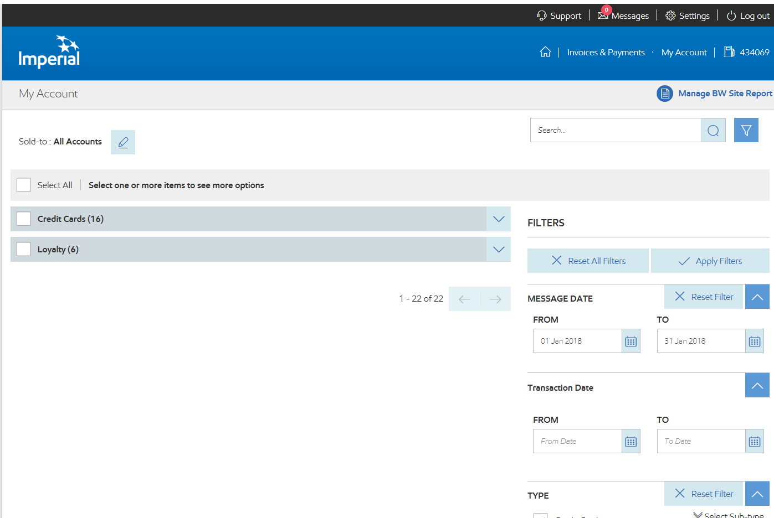
Portal - Message centre
Notes:
SAY
This is the page where you will go daily to check for new DTN reports.
It displays all the settlement and loyalty messages you receive on a specific date. You can filter for a specific report or many reports over a period of time. From here you can also view, sort and print reports as needed. The type of report listed is noted by a three letter code. This code represents the report name and it is used consistently throughout the portal and on each report.
SAY
Now that you’ve had a chance to see the portal, have you used a similar online tool before?
We expect that you have worked with something similar to this before. For those of you that haven’t, and those of you that have, there is support and training for you, which we’ll talk about in a few minutes.”

Slide 13
Portal – Retailer reports
BWs select reports to be sent to Retailers
Retailers receive the reports via email
Selected reports sent automatically when available
Notes:
SAY
From the portal, you’ll also be able to control site settlement and loyalty reports for Retailers. You will select reports to be sent via email to each Retailer directly from the portal. The reports are sent automatically as soon as they are available, providing up-to-date information for sites to use for reconciliation.

Slide 14
New reports
Code | Report Name | Description
Credit Card Reports |  |  | BW | R
CCM | Card Settlement Report | Day/Shift summary totals and adjustments |  | 
DFM | Daily Card Sales Fee Report | Daily summary of total sales and card fees by card type |  | 
FMM | Monthly Card Sales Fee Report | Monthly summary of the daily card sales fee reports |  | 
PCR | Price Privileges/Car Wash Redemption Report | Price Privileges/Car Wash dollar amounts for loyalty points redeemed. |  | 
MSR | Multiple Sales Report | Daily report identifying multiple inside sales (credit only; no debit or Fleet) by truncated card number, to help detect possible fraud |  | 
Notes:
Now that you know a little bit about the online portal and how you will use it, let’s take a look at the new reports that are available to you and your sites, and what information they provide. Note that in the DTN portal, Retailers are referred to as Dealers.
Here is the list of new reports and a brief description of each. You can see here that each report is identified by the same 3 letter code we just saw in the portal Message Centre. Please note there are a number of reports under development which will become available to you with further system developments.
As a BW, you will most likely use:
CCM - Card Settlement Report – for Day/Shift summary totals and adjustments.
DFM - Daily Card Sales Fee Report – for a daily summary of total sales and card fees by card type.
FMM - Monthly Card Sales Fee Report for a Monthly summary of the daily card sales fee reports.
And the PCR - Price Privileges/Car Wash Redemption Report for Price Privileges/Car Wash dollar amounts for loyalty points redeemed.
MSR - Multiple Sales Report - Daily report identifying multiple inside sales (credit only; no debit or Fleet) by truncated card number, to help detect possible fraud
RTV - Ticket Requests - Periodic report – Ticket retrieval request

Slide 15
New reports (cont.)
Code | Report Name | Description
Loyalty Reports |  |  | BW | R
LRD | Daily Loyalty Detail Report | BW Loyalty Detail Report (LRD): LRDa: Transaction level dollar amounts for loyalty points issued/redeemed for all BW Dealers LRDb: Transaction level details for loyalty points issued/redeemed for all BW Dealers | 
 |  | Dealer Loyalty Detail Report (LDD): LDDa: Transaction level dollar amounts for loyalty points issued/redeemed LDDb: Transaction level details for loyalty points issued/redeemed |  | 
LRS | Daily Loyalty Summary Report | Loyalty program summary data by Dealer with BW totals | 
LMS | Monthly Loyalty Summary Report | Monthly roll up of loyalty activity for all BW Dealers | 
LPF | Daily Loyalty Potential Fraud | Periodic report – Summary of cards that were used multiple times at a site in one day |  | 
Notes:
Additional reports include:
The BW Loyalty Detail Report (LRD):
LRDa: Transaction level dollar amounts for loyalty points issued/redeemed for all BW Dealers
LRDb: Transaction level details for loyalty points issued/redeemed for all BW Dealers
The LRS: Daily Loyalty Summary Report which displays Loyalty program summary data by Dealer with BW totals
And the LMS - Monthly Loyalty Summary Report – which is a Monthly roll up of loyalty activity for all BW Dealers.

Slide 16
Support – Training
Virtual DTN portal training
Notes:
SAY
We’ve completed a basic introduction to the online portal and the new reports. Let’s look at the support available to you.
To learn more about the DTN portal and managing the reports available to you, you can attend a virtual training session. This session will help you learn how to navigate the DTN portal, manage your own reports, and manage Dealer, or Retailer, profiles.
We’ll provide more information on these sessions at the end of this webinar.

Slide 17
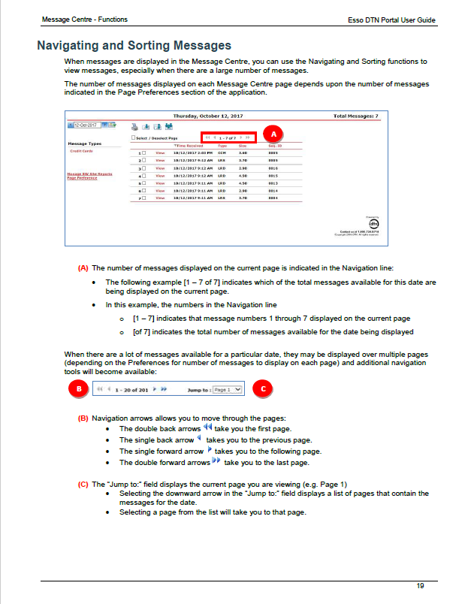
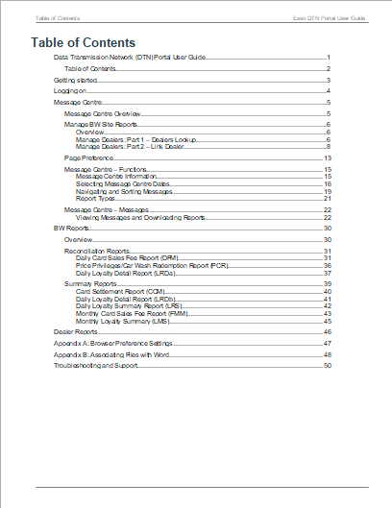
Support - DTN User Guide
Notes:
SAY
For more detailed information on the new reports, you can refer to the DTN User Guide. This guide explains how you can access and use reports for reconciliation, and shows you how to manage the reports that are sent to Retailers.
The DTN User Guide is a PDF that you can view online or print and keep. Note that the content will be updated over time. If you print it, check back from time to time for any updates that have been made.

Slide 18
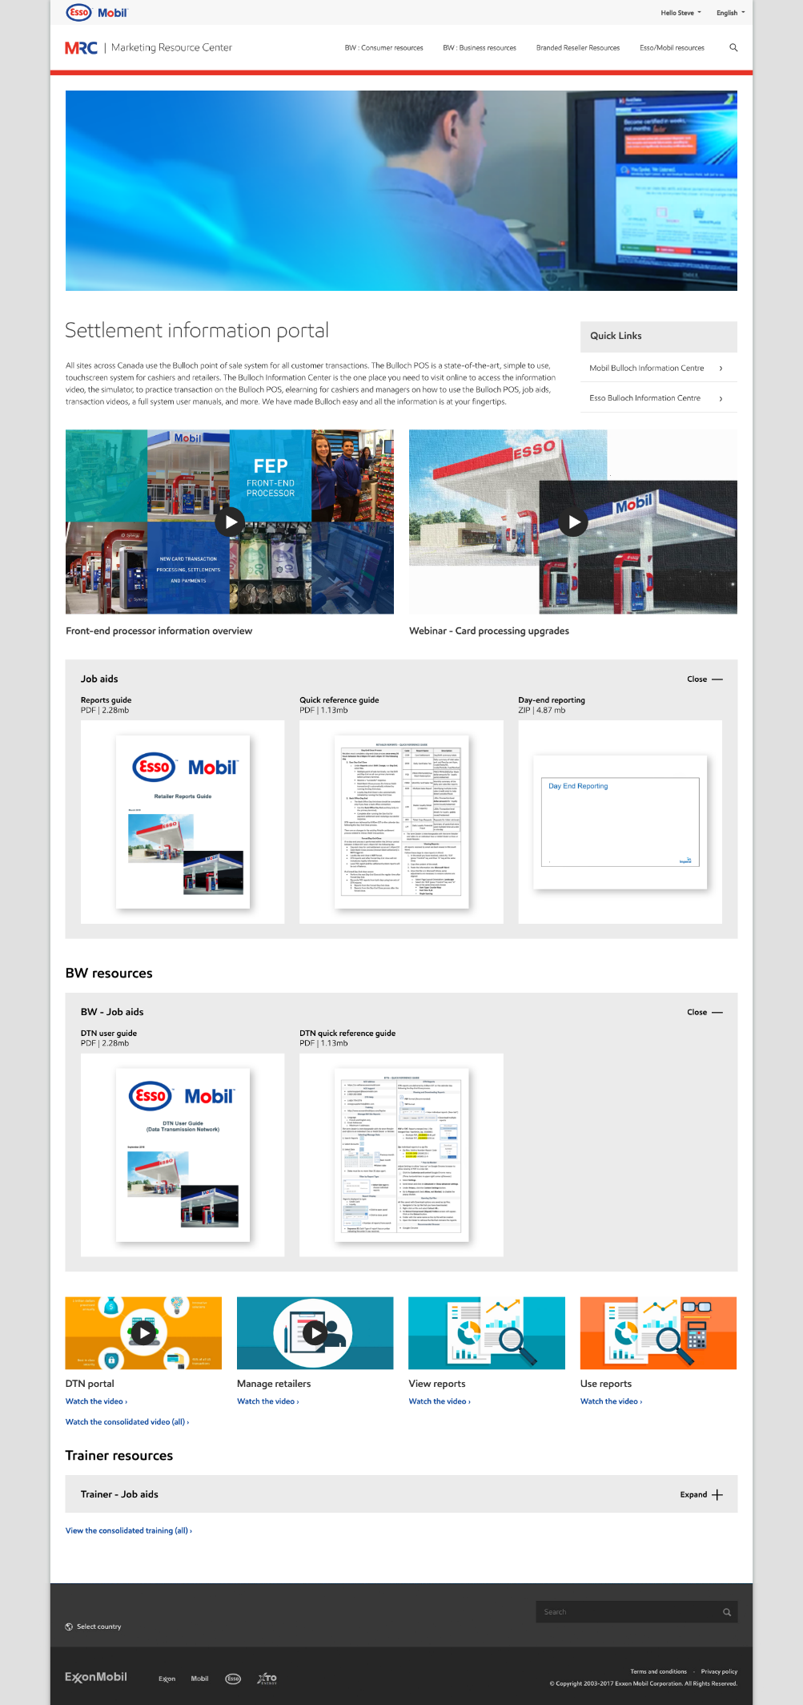
Settlement information portal
Introduction video
Retailer – Webinar recording
Retailer Reference Guides
Notes:
SAY
In addition to this training today, there are a number of resources to support you. They can all be found in one convenient, easy-to-access location: the Settlement Information Portal.
This is the same portal you may have used to access resources about the Bulloch point-of-sale system when it was rolled out. There is a new page at the same web location to provide support for the card processing upgrades.
On this page you will find a video that introduces the card processing upgrades coming to all sites, resources for Retailers and links to resources for BWs and their trainers.

Slide 19
Settlement information portal - BW
DTN User Guide
DTN Quick Reference Guide
DTN Training Videos
Trainer - Job Aids
DTN Help: 1-800-779-5779
Notes:
SAY
This is the BW Resources page. This page includes a recorded version of the DTN virtual training we mentioned a few minutes ago. The recording of this training can be helpful to refresh your memory, and when you have new Managers coming on to the site.
Also on this web page is a recording of this training, the DTN User Guide and some Quick Reference Guides to support you in using the DTN portal and navigating the updated processes.
Note the website resources will be updated as new reports become available. It will be useful to check the site periodically.
One other support for you when using the DTN portal is the DTN Help number. You can see it here. It is also in the DTN Quick Reference Guide.

Slide 20
What can you do to prepare your business to use the DTN portal to access and manage new reports?
Notes:
SAY
Let’s pause for a minute and have you think about: What can you do to prepare your business to use the DTN portal to access and manage new reports?
Here are some suggestions:
Attend training, designate a person to be responsible DTN portal management and become familiar with navigating the portal before our sites go live with the card processing upgrade.
Preparing for the change will help keep operations running smoothly during the transition.

Slide 21
Poll question
Notes:
TIME 1 min
FACILITATOR NOTE
If you are facilitating this virtually as a webinar, use this slide to introduce the poll question. Type the poll question and answers into the WebEx (or other software) poll feature before the webinar. Bring the question up when you come to this slide.
If you are facilitating this face-to-face, use the next two slides to present the poll question and responses. They are hidden in this presentation. To unhide them, in Normal view, select the slide on the left hand list of slides, right click and deselect “Hide Slide” from the menu.
POLL QUESTION
What can you do to prepare your business to use the DTN portal to access and manage new reports?
Attend training
Designate a person to be responsible DTN portal management
Become familiar with navigating the portal before our sites go live with the card processing upgrade
All of the above
SAY
The correct answer is D – All of the above. Preparing for the change will help keep operations running smoothly during the transition.

Slide 22
Poll question
What can you do to prepare your business to begin using the portal to access and manage new reports?
Attend training
Designate someone to access the portal and manage the reports
Become familiar with navigating the portal before your sites go live with the card processing upgrade
All of the above
Notes:
TIME 1 min
FACILITATOR NOTE
This and the next slide are for face-to-face presentation use.
POLL QUESTION
What can you do to prepare your business to begin using the portal to access and manage new reports?
Attend training
Designate someone to access the portal and manage the reports
Become familiar with navigating the portal before your sites go live with the card processing upgrade
All of the above
SAY
The correct answer is D – All of the above. Preparing for the change will help keep operations running smoothly during the transition.

Slide 23
Poll question
What can you do to prepare your business to begin using the portal to access and manage new reports?
Attend training
Designate someone to access the portal and manage the reports
Become familiar with navigating the portal before your sites go live with the card processing upgrade
All of the above
Notes:
TIME 1 min
FACILITATOR NOTE
This slide is for face-to-face presentation use.
POLL QUESTION
What can you do to prepare your business to begin using the portal to access and manage new reports?
Attend training
Designate someone to access the portal and manage the reports
Become familiar with navigating the portal before your sites go live with the card processing upgrade
All of the above
SAY
The correct answer is D – All of the above. Preparing for the change will help keep operations running smoothly during the transition.

Slide 24
?
Check-in
Questi ns
Notes:
TIME 2 min
FACILITATOR NOTE
If there are 5 or less participants or if this is being facilitated face-to-face, participants can ask questions by unmuting (webinar) or just asking (face-to-face).
For a webinar with 6 or more participants, direct them to use the text chat feature to ask questions.
SAY
You’ve taken in a lot of new information. Let’s take a moment to check in. What questions or comments do you have?

Slide 25
MODULE 1
MODULE 2
MODULE 3:
DAY END PROCESS
MODULE 4
Notes:
SAY
Alright, let’s move on to Module 3, Day End Process.
As part of the upgrade, another update for Retailers is the revised day-end process. To ensure the most up-to-date data is included in the new reports, and to help with effective and efficient business operations, the payment settlement system requires a day-end close to be performed once every 24 hours. Although this change has the biggest impact on Retailers, it will be good for you to know to help you support them through the upgrade.
Let’s talk about what this change means for you and your sites.

Slide 26
Day-end Close every 24 hours
Perform a day-end close once every 24 hours between
2:00 pm and 1:45 pm EST the next day
Perform close by
11:59 pm EST
Notes:
SAY
Once a site is switched over, they’ll need to perform a day-end close with BAMS/FD once every 24 hours between 2:00 pm EST one day and 1:45 pm EST the next. To receive the most up-to-date reports, we recommend running the day-end close as close to 11:59 pm EST as possible. Running the day-end close as close to 11:59 pm EST as possible will capture the most recent transactions in the reports that are generated the next day.

Slide 27
daily day-end close process
Day-End Close:
Under Reports, select Shift Change
When prompted to run Day End, select Yes
Debit batch close process triggered automatically by performing Day-End close
Loyalty Day-End close also triggered automatically
Notes:
SAY
Along with the daily close, there is an updated process for Retailers to perform the day-end. Let’s take a look.
First, they will run a shift-end on the Bulloch POS by selecting Reports and then selecting Shift Change. When they select the Shift Change push key, a prompt will pop up. It will ask if they also want to perform a day-end. Selecting Yes. will run both the shift-end and day-end on this terminal.
Directly after they’ve performed the day-end close on the payment settlement system, they will receive a successful response from BAMS/FD.
Performing the day-end close initiates both the Debit Batch Close process and the Loyalty day-end process automatically. There are no changes to the existing Retailer settlement process related to Interac Debit transactions.
Note that if the site has a back office connection, they will complete a back office day end after receiving a successful response from the day-end close. To run the back off day end, on the POS, select the Reports push key and then select the Back Office Day End push key.

Slide 28
Day-end with multiple pos terminals
Step 1: Non-primary POS
Step 2: Primary POS
Step 3: Primary POS
Run shift & day-end on non-primary terminals
Run shift & day-end on primary terminal
If there is a Back Office connection, run a Back Office Day End on primary terminal
Text placeholder that goes on 2 lines
Text placeholder
Text placeholder
Notes:
SAY
If the site has multiple point-of-sale terminals, they will run the shift and day-end on all non-primary terminals first. Then, perform a final shift and day-end on the primary terminal.
The Back Office Day End push key will appear only on the primary or master terminal. Finally, if the site has a Back Office connection, perform a Back Office Day End on the primary terminal

Slide 29

Timing of Retailer reports
Retailers will receive DTN reports via email on a daily basis by ~6 am EST, for the day-end close completed the previous calendar day.
Notes:
SAY
Regardless of what time a Retail site closes each day, BAMS/FD begins processing the day-end close information from the system at 11:59 am EST every day. The Retailer DTN reports will be available approximately 6 hours later. To see what this means, let’s look at a few examples.

Slide 30
day-end process – Example 1
Perform day-end close before 11:59 pm EST Tuesday:
Receive a successful day-end close response from First Data
DTN reports available by
~6:00 am EST Wednesday
Note: For all scenarios, timing for Moneris payment for Debit transactions stays the same as today.
Notes:
SAY
For this first example, let’s say a site performs the day-end close process before 11:59 pm EST on Tuesday. Let’s assume we are working in Eastern Standard Time:
For this example, the site runs the shift end and day-end close on each POS before 11:59 pm EST on Tuesday. When they receive a successful response from First Data, their day-end is complete for payment, loyalty settlement and debit batch close.
Any DTN reports the Retailer receives by email will then be available by approximately 6:00 am EST on Wednesday.
Note that for all scenarios, timing for Moneris payments for Debit transactions will remain unchanged from when Retail sites currently receive them.

Slide 31
day-end process – Example 2
Perform day-end close after
11:59 pm EST Tuesday
(i.e. on Wednesday):
Receive a successful day-end close response from First Data
DTN reports available by
~6:00 am EST Thursday
Notes:
SAY
Now let’s look at an example of a site that performs their day-end after 11:59 pm EST:
After running the shift end and day-end on each POS terminal, the loyalty day-end and debit batch close are triggered automatically. When the site receives a successful day-end close response from First Data they can run the Back Office Day End (if applicable) and then begin the next day’s sales.
After successfully running a day-end, the new reports from the DTN portal will be available by 6:00 am EST Thursday.
A key point for Retailers is, when their site is converted, there will be a 1 to 2 day period when they will not receive DTN reports. If they perform their close before 11:59 pm EST, it will be 1 day. If they perform their close after 11:59 pm EST, it will be 2 days.
After that, if they close at the same time each day, they will receive reports daily. We recommend performing the day-end close around the same time each day to ensure reports are received daily and funding is received consistently.

Slide 32
What if I miss the cut-off time?
If a site hasn’t performed a day-end close in the last 24 hours:
At 1:45 pm EST, BAMS/FD will force a day-end close
Loyalty day-end close (and debit settlement) won’t occur
Local POS report and settlement system report will not balance
Notes:
SAY
So what happens if a site doesn’t perform a day-end close within 24 hours?
At 1:45 pm Eastern Standard time, BAMS/FD will automatically close the day, pulling the site data from their end. This forced day-end will NOT trigger the loyalty day-end close or debit batch close to be completed.
When the site runs the loyalty day-end and debit batch close after 1:45 pm EST, they will be out of balance with the credit and gift card settlement. Also, the local POS report and the settlement system report will not balance.

Slide 33
Reconciling after a forced close
Wait until next regular day-end close time
Perform the day-end close process (day-end and loyalty day-end)
Reconcile using combined report from the day-end close. It will contain 2 days of data.
Notes:
SAY
If a site has missed the day-end close cut off time and BAMS/FD forced the day-end close, we recommend they do the following:
Wait until the next regular day-end closing time to run a day-end close. Then, they will reconcile both days using one combined report. It will include the data from the forced close, and the data from the day-end completed the next day (the day after the forced close). They will have more data to reconcile, but the combined DTN reports should balance with the combined local ones.
As mentioned a few moments ago, Retailers can easily avoid this situation by performing the day-end at approximately the same time every day.
What is important for you to know is, as a BW, you will not see any Loyalty settlement for that day.

Slide 34

Alerts & reminders
Customizable alerts
Reduced out-of-balance situations
Notes:
SAY
To help with the updated process, Retailers will be able to set customizable alerts on their point of sale systems as a reminder to perform the day-end by the correct time. As a result of this daily close, Retail sites will see a reduction in out-of-balance situations when reconciling site totals with data in settlement.

Slide 35
Thinking about the sites you manage, how can you best support them with this change?
Notes:
SAY
It’s now time for another pause to think about the sites you manage. How can you best support them with this change?
Some suggestions are:
Deliver the training provided by Imperial Oil, develop a plan to communicate the changes to Retail sites and check in with Retailers as they are implementing the change.
As the BW, your role is to communicate the updated process to sites, and support them with what they need to be successful. Similar to the webinar you are taking now, Retailers will have the opportunity to attend a webinar to learn about the new solution and how it affects them.

Slide 36
Poll question
Notes:
TIME 1 min
FACILITATOR NOTE
The purpose of this poll is to generate thinking and conversation. There is no wrong answer.
If you are facilitating this virtually as a webinar, use this slide to introduce the poll question. Type the poll question and answers into the WebEx (or other software) poll feature before the webinar. Bring the question up when you come to this slide.
If you are facilitating this face-to-face, use the next two slides to present the poll question and responses. They are hidden in this presentation. To unhide them, in Normal view, select the slide on the left hand list of slides, right click and deselect “Hide Slide” from the menu.
POLL QUESTION – SELECT THE BEST RESPONSE. ALL ANSWERS ARE CORRECT
Thinking about the sites you manage, how can you best support them with this change?
Deliver the training provided by Imperial Oil
Develop a plan to communicate the changes to Retail sites
Check in with Retailers as they are implementing the change
Other
DO
Review and comment on responses as they are entered. If any participant responded “Other”. Ask if they would like to go off mute and share their ideas.
SAY
Thank you for sharing your ideas. As the BW, your role is to communicate the updated process to sites, and support them with what they need to be successful. Similar to the webinar you are taking now, Retailers will have the opportunity to attend a webinar to learn about the new solution and how it affects them.

Slide 37
Poll question
Thinking about the sites you manage, how can you best support them with this change? All answers are correct.
Deliver the training provided by Imperial Oil
Develop a plan to communicate the changes to Retail sites
Check in with Retailers as they are implementing the change
Other
Notes:
TIME 1 min
FACILITATOR NOTE
This slide is for face-to-face presentation use.
POLL QUESTION
Thinking about the sites you manage, how can you best support them with this change?
Deliver the training provided by Imperial Oil
Develop a plan to communicate the changes to Retail sites
Check in with Retailers as they are implementing the change
Other
DO
Review and comment on responses as they are entered. If any participant responded “Other”. Ask if they would like to go off mute and share their ideas.
SAY
Thank you for sharing your ideas. As the BW, your role is to communicate the updated process to sites, and support them with what they need to be successful. Similar to the webinar you are taking now, Retailers will have the opportunity to attend a webinar to learn about the new solution and how it affects them.

Slide 38
MODULE 1
MODULE 2
MODULE 3
MODULE 4:
OTHER UPDATES
Notes:
SAY
Let’s continue on.
We’ve covered the processes related to reports and day end close. These are the changes with the biggest impact to you. There are a few other process changes to tell you about, so let’s do that now.

Slide 39
Pre-authorized transactions
Credit card transactions pre-authorized
Notes:
SAY
All site credit card transactions will be pre-authorized. This will provide better fraud protection for both you and the customer. As a result, sites will no longer need to pre-authorize a credit card by processing a one cent transaction.

Slide 40
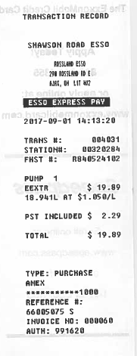
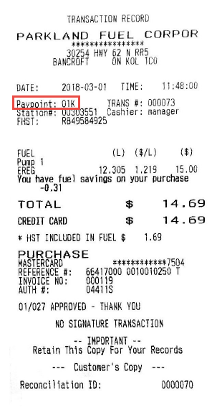
ID Number
Transaction and receipt identification numbers
Notes:
SAY
Last, In future, when you or Retail sites receive requests related to transactions or receipts, they will be identified by the invoice number and either the pump number or pay point number. This will replace the three character terminal ID currently being used.

Slide 41
How do you plan to communicate the updates to Retailers?
Notes:
SAY
Okay, now to one of the most important topics.
These updates will provide you and your sites with more simplified, up to date processes to help you and the business as a whole, remain competitive.
Most of the new processes will have a larger impact on the Retailers and the sites they manage. Thinking of your regular communication channels with your sites, in what ways do you plan to communicate the updates to them? For example, perhaps you hold monthly meetings with Retailers, or send out weekly email updates.
What can you do?
Thank you for thinking about this. Building on these ideas, there are resources and support to assist you with communicating the change.

Slide 42
SUPPORT &
NEXT STEPS
To Do List:
Plan communications to Retail sites about the updates to come.
Take the virtual training to learn how to navigate the DTN online portal and new reports.
Access the Settlement Information Portal and review the resources there including DTN User Guide and Quick Reference.
Plan training to prepare Retailers for the updates.
Notes:
SAY
Let’s talk about next steps and support available to you and to Retailers.
For you (BW’s): In addition to planning communications to sites, you have a couple of other next steps to take. Imperial is providing training materials to support you. As a BW, we mentioned earlier that you’ll attend a virtual session that will show you how to navigate the DTN portal and the reports that will be available.
In addition, you can go to the Settlement Information Portal website and check out the DTN User Guide for a detailed description of the reports as well as some quick references to provide additional support.
For Retailers: As mentioned earlier, Retailers will be able to attend a webinar similar to this one, customized to their needs. They will also have access to a Reference Guide to help them navigate the new reports. As before, sites will contact Retail Help Desk for troubleshooting assistance.

Slide 43
?
Q & A
Questi ns
Notes:
TIME 6 min
FACILITATOR NOTE
If there are 5 or less participants or if this is being facilitated face-to-face, participants can ask questions by unmuting (webinar) or just asking (face-to-face).
For a webinar with 6 or more participants, direct them to use the text chat feature to ask questions.
SAY
That completes the summary of the updated and simplified solution to front-end processing and settlement. Thank you for attending and for your participation today. We have some time left to address any questions you might have. What questions or comments do you have?

Slide 44
THANK
YOU
Notes:
That completes the summary of the updated and simplified solution to front-end processing and settlement. Thank you for attending and for your attention today. If you have any questions or comments, please remember to reach out to your support team.
Thank you again for attending.

